Slide 1
Authentication, Part 2
CptS 427 – Applied Cyber Security William Hutton, PhD, CISSP

Slide 2
The Purpose of Authentication
How to prove, “You are who you say you are.”
This includes machines!
Earliest (and still most common) method of authentication is the password.
Something you know.
Other forms of authentication:
Something you have
Something you are
Notes:
Reminder from the previous presentation.

Slide 3
William Stallings on Authentication
”User authentication is one of the most complex and challenging security functions.” (Stallings 124)
”There is a wide variety of methods of authentication, with:
Associated threats
Risks
Countermeasures” (Stallings 124)
Authentication allows organizations to secure their resources by protecting access to computer systems, networks, databases, websites, and other applications and services. (Stallings 124)
Authentication is a prerequisite to authorization (i.e. access control) (Stallings 121)
Notes:
Sorry for the “wall of text”, but this sums things up nicely.
Stallings is a prolific computer security author. These is all taken from “Information Privacy Engineering and Privacy by Design” (2020)

Slide 4
Different Authenticators
Factor | Examples | Properties
Something you know | User ID, Password, PIN | Can be shared Can be guessed Can be forgotten
Something you have | Smart card, RSA token, Ubikey, MFA (via SMS or other means) | Can be shared Can be duplicated (cloned) Can be lost Can be stolen
Something you are | Fingerprint, Face, Iris, Voice print | Not possible to share* False positives False negatives Difficult to forge*
Notes:
Source: “Information Privacy Engineering and Privacy By Design” (pg. 126)
NIST 800-63 “Digital Identity Model” defines a general model for user authentication.

Slide 5
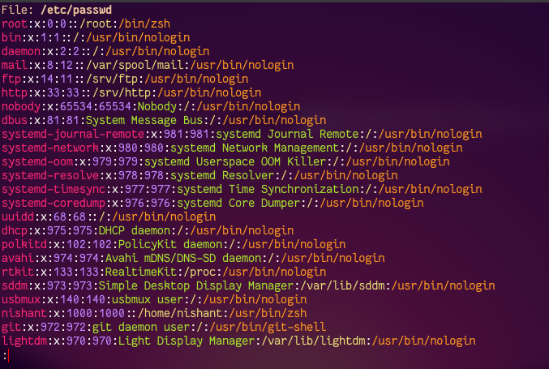
Linux Authentication
/etc/password
/etc/shadow
Early passwords were stored “in the clear”
Readable by all
Mitigations:
Hashes
/etc/shadow

Slide 6
Windows Authentication
Local
SAM Database
Easily defeated with physical access
Network
NTLM
Challenge/Response
No salt
Vulnerable to replay
NTLMv1
NTLMv2
Kerberos
Notes:
SAM = Security Account Manager

Slide 7
Windows Authentication
Local
SAM Database
Easily defeated with physical access
Network
NTLM
NTLMv1
8-byte random number challenge
24-byte response (computed from shared secret)
Uses DES (Early 1970s!)
NTLMv2
Kerberos
Notes:
SAM = Security Account Manager

Slide 8
Windows Authentication
Local
SAM Database
Easily defeated with physical access
Network
NTLM
Challenge/Response
No salt
Vulnerable to replay
NTLMv1
NTLMv2
Not recommended by MSFT since 2010!
Kerberos
Notes:
SAM = Security Account Manager

Slide 9
The Kerberos Protocol
User authentication service developed by MIT
v4 (1988)
V5 (1994)
Allow servers to restrict access to authenticated users
Can also authenticate servers to users
v4 no longer widely used, but easier to start there because Kerberos is complex.
v5 fixes some security issues in v4 (both are military specs).
RFC 4120

Slide 10
A simple Kerberos authentication Dialogue
Client 1
Client 2
Client 3
Server A
Server B
Server C

Slide 11
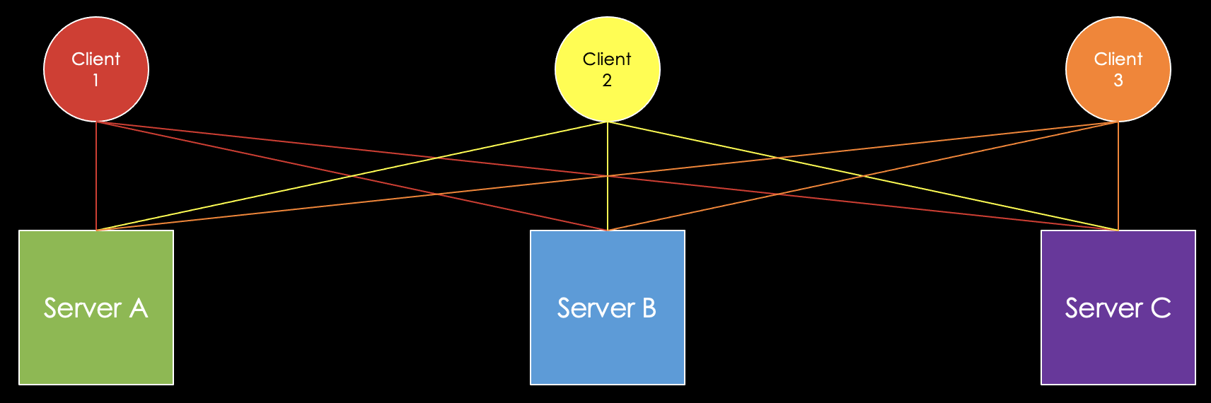
Simple authentication dialogue
Unprotected network
Any client can request a service from any server
Primary threat is impersonation
Servers must confirm identities of clients.
This can be a burden on a server in a large, open environment.

Slide 12
A simple Kerberos authentication Dialogue
Authentication Server
Client 1
Client 2
Client 3
Server A
Server B
Server C

Slide 13
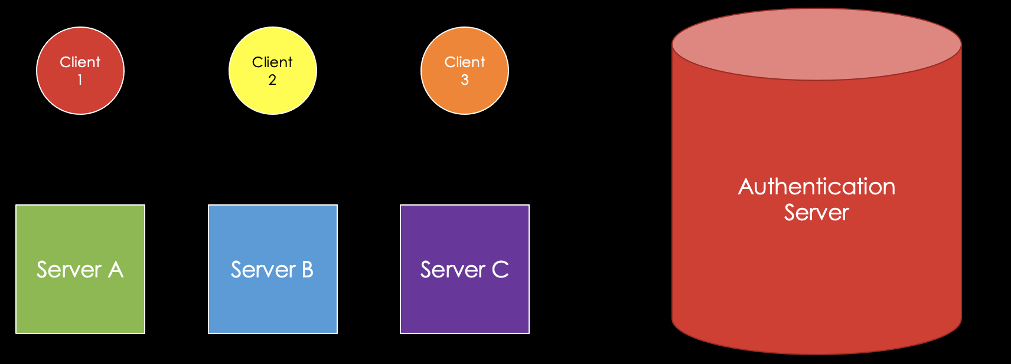
Simple authentication dialogue
Authentication server contains:
Passwords of every client
Unique secret key for each server

Slide 14
A simple Kerberos authentication Dialogue
Authentication Server
Client 1
Client 2
Client 3
User ID,
User Password,
Server ID
Server A
Server B
Server C

Slide 15
A simple Kerberos authentication Dialogue
Authentication Server
Client 1
Client 2
Client 3
User ID,
User Password,
Server ID
Server A
Server B
Server C
?

Slide 16
A simple Kerberos authentication Dialogue
Authentication Server
Client 1
Client 2
Client 3
User ID,
User Password,
Server ID
Server A
Server B
Server C
No!

Slide 17
A simple Kerberos authentication Dialogue
Authentication Server
Client 1
Client 2
Client 3
User ID,
User Password,
Server ID
Server A
Server B
Server C
Yes

Slide 18
A simple Kerberos authentication Dialogue
Authentication Server
Client 1
Client 2
Client 3
Server A
Server B
Server C
Ticket

Slide 19
Simple authentication dialogue
If the Authentication Server can authenticate the user AND the user has access to the server, the Authentication Server creates a ticket.
Ticket
User ID: Client 3
Address: 192.168.10.212
Server ID: Server C

Slide 20
Simple authentication dialogue
If the Authentication Server can authenticate the user AND the user has access to the server, the Authentication Server creates a ticket.
The Authentication Server then encrypts the ticket with the unique secret key for the specified server.
Ticket
cdfee2bc43d63caeaa3b169ad31e966c

Slide 21
Simple authentication dialogue
If the Authentication Server can authenticate the user AND the user has access to the server, the Authentication Server creates a ticket.
The Authentication Server then encrypts the ticket with the unique secret key for the specified server.
The user (client) does not have the server key, so they cannot alter the ticket.
Ticket
cdfee2bc43d63caeaa3b169ad31e966c

Slide 22
Simple authentication dialogue
The user (client) does not have the server key, so they cannot alter the ticket.
Recall the ticket contains the address of the client, so the ticket cannot be replayed by another client or another workstation.
Ticket
cdfee2bc43d63caeaa3b169ad31e966c

Slide 23
A simple Kerberos authentication Dialogue
Message
Client 3
Authentication Server
Client 1
Client 2
Client 3
Server A
Server B
Server C

Slide 24
A simple Kerberos authentication Dialogue
Message
Client 3
Authentication Server
Client 1
Client 2
Client 3
Ticket
Server A
Server B
Server C

Slide 25
Simple authentication dialogue
The server decrypts the ticket from the client using the server’s unique key that it shares with the Authentication Server.
Then the plaintext client ID is compared to the decrypted client ID:
If they match, the client is granted access to the server.
Server C
Plaintext ID =
Decrypt(Ticket) -> ID

Slide 26
What problems do you see with this approach?
Simple Kerberos v4 Authentication Dialogue
Notes:
Topics may include:
Protecting the Authentication Server (it has all the client passwords and server keys)
Server key distribution and management
Client revocation
Expiring tickets
Potential loss of password confidentiality between client and AS.
Other ideas? (v5 of Kerberos addresses this, as well as more complicated authentication examples)

Slide 27
Additional Kerberos Authentication Messages
More secure authentication dialogues (different encryption algorithms and client/server negotiation)
v5 replaces DES with flexible encryption algorithms
v5 allows addresses other than IPv4
v5 allows for arbitrary ticket lifetimes (not 5-min increments with a maximum of 1,280 minutes or ~21 hours)

